Slide 1

The Battle of Endor
Houston R Users Group
2/7/2016
Jonathan Bennett
www.konoanalytics.com

Slide 2



Data Stewardship
Process Automation
Actionable Insight
www.konoanalytics.com

Slide 3
Strategic Questions:
1) IF we should deploy the Stormtroopers?
2) WHEN we should deploy the Stormtroopers?
www.konoanalytics.com

Slide 4
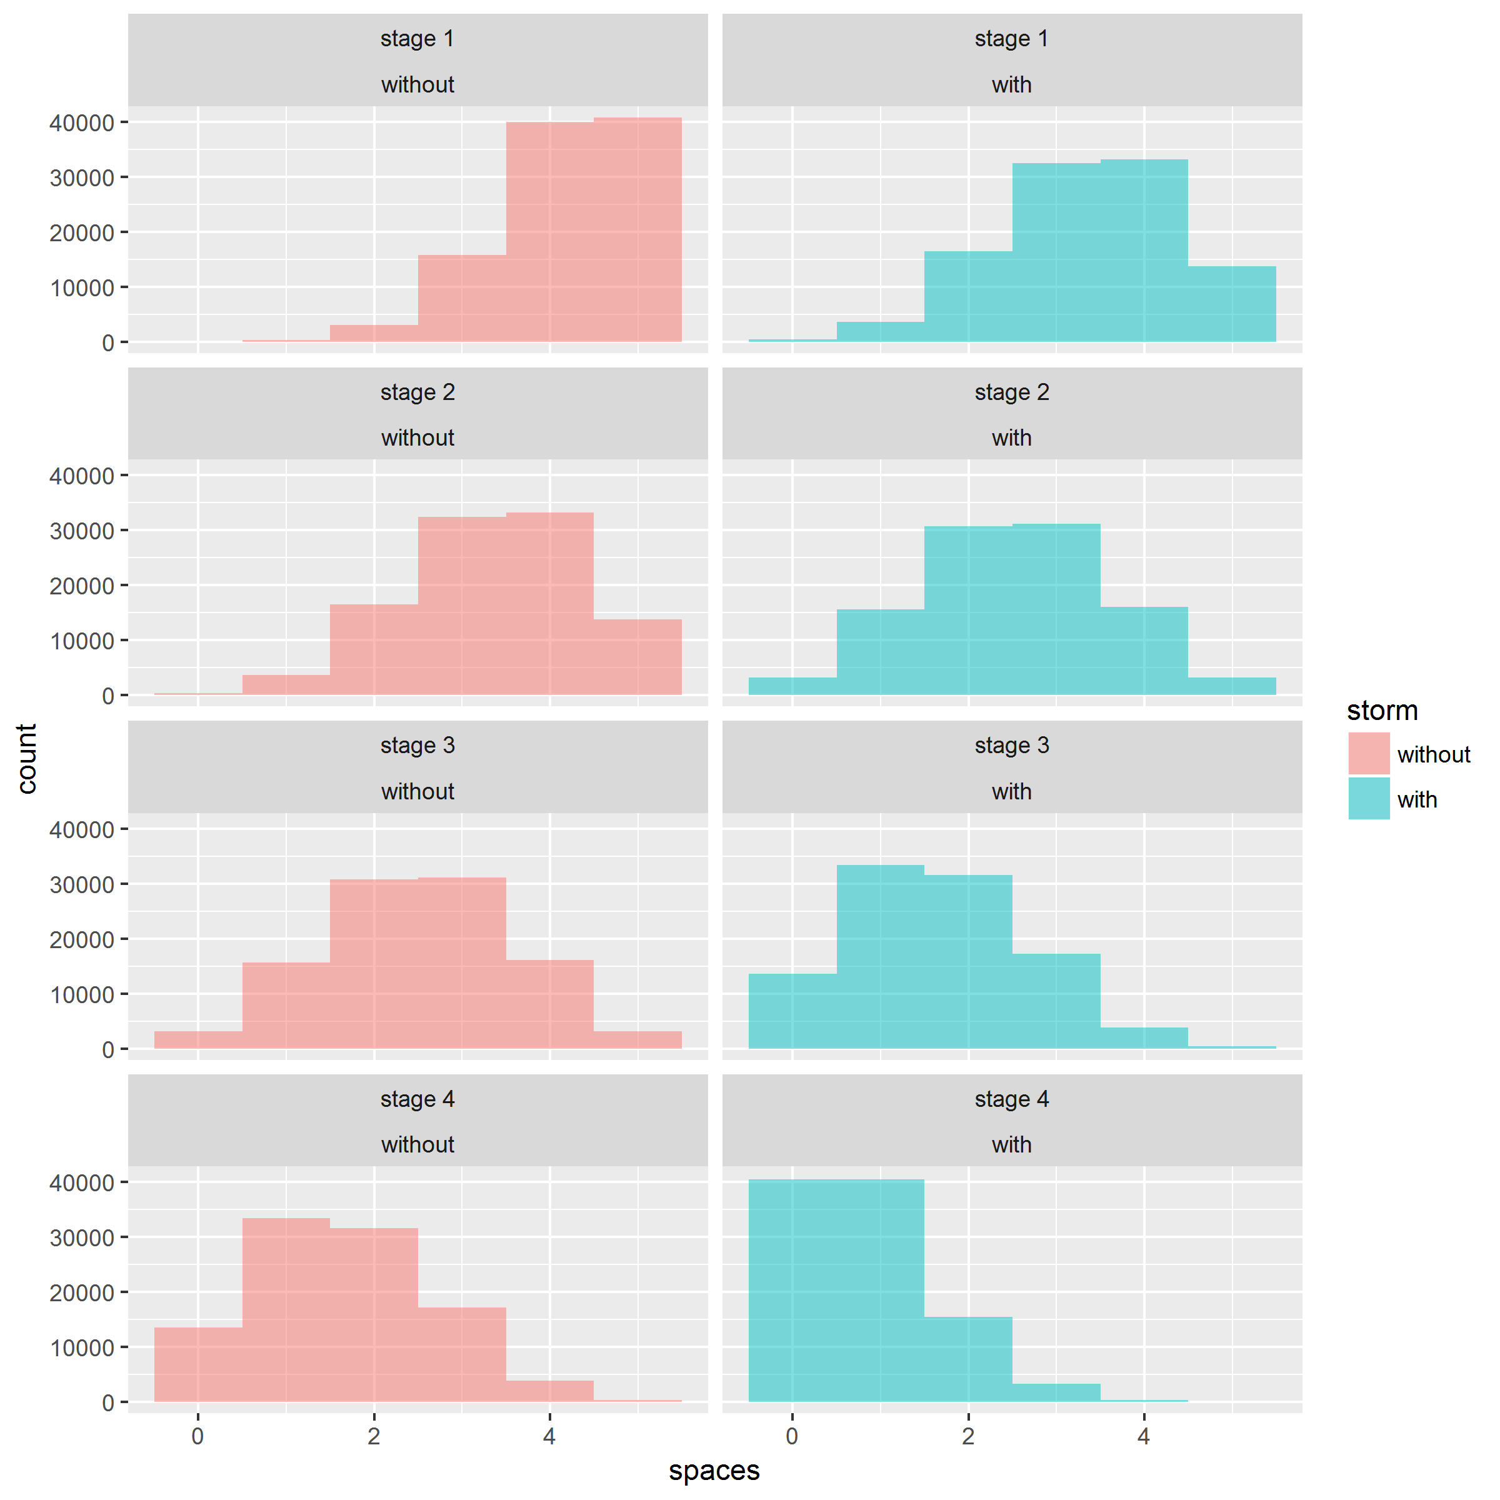
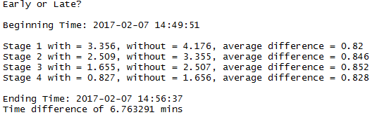
When (What Stage)
www.konoanalytics.com

Slide 5
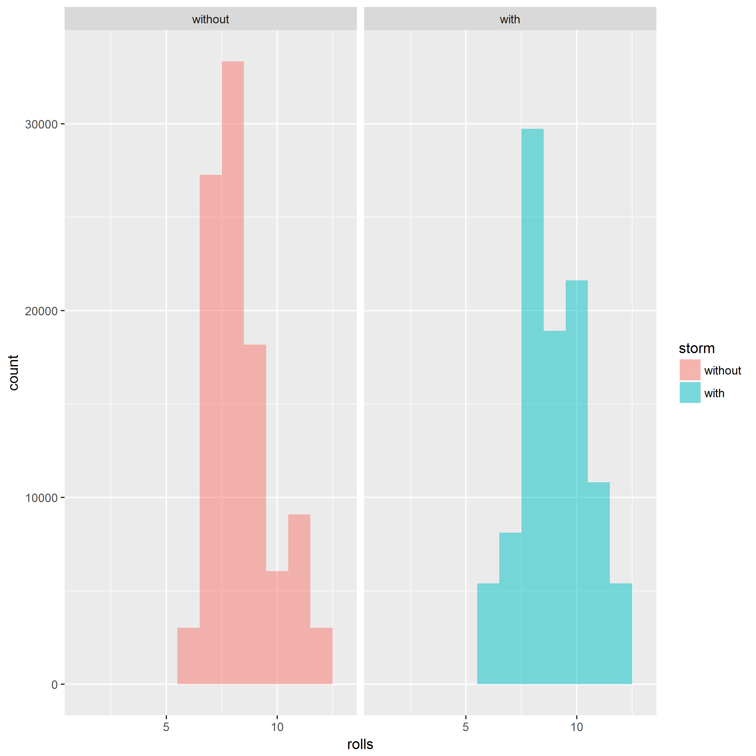
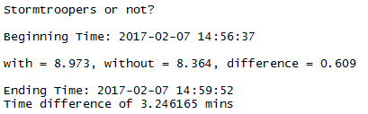
If (Is the effort worth it?)
www.konoanalytics.com

Slide 6
Conclusion
1) Don’t deploy the Stormtroopers – save your moves for other theaters of the game
2) If you must deploy, timing isn’t terribly important
www.konoanalytics.com

Slide 7
Methodology
hrug()
endor_earlyorlate()
endor_simulation()
endor_roll()
endor_stormornot()
endor_wholeplanetsim()
www.konoanalytics.com
https://github.com/KonoAnalytics/BoardGames

Slide 8
www.konoanalytics.com

Slide 9
www.konoanalytics.com

Slide 10
www.konoanalytics.com

